Slide 1
Revision Dominating-vs-Dominated
2026.02.24
Hayeon Jeong

Slide 2
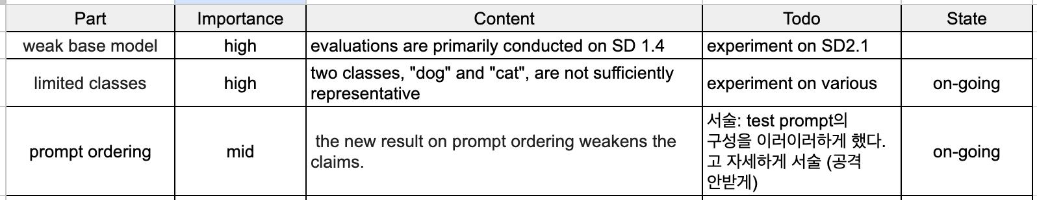
Weaknesses
I have read the rebuttal and appreciate the effort and additional experiments and analyses. Specifically, the evaluation on SDXL and PixArt, the prompt order sensitivity study, and the extended attention visualizations. These indeed strengthen the paper, but I remain sceptical. I am still not fully convinced that the presented evidence conclusively establishes the proposed root cause of DvD. In particular, the remaining sensitivity to prompt ordering and the very limited set of models and classes. I think that it is more involved, and I believe that there is no significant contribution to our understanding of advanced models. I will keep my score.
The authors address some of the concerns raised by the reviewers, including verifying the DvD phenomenon in two newer models, prompt ordering sensitivity, a preliminary mitigation suggestion, and a few analyses. However, I still believe the scope of the experiments are too small, particularly for the generalization across classes (two classes, "dog" and "cat", are not sufficiently representative) and thorough evaluations across multiple models (evaluations are primarily conducted on SD 1.4). Additionally, the new result on prompt ordering weakens the claims.

Slide 3
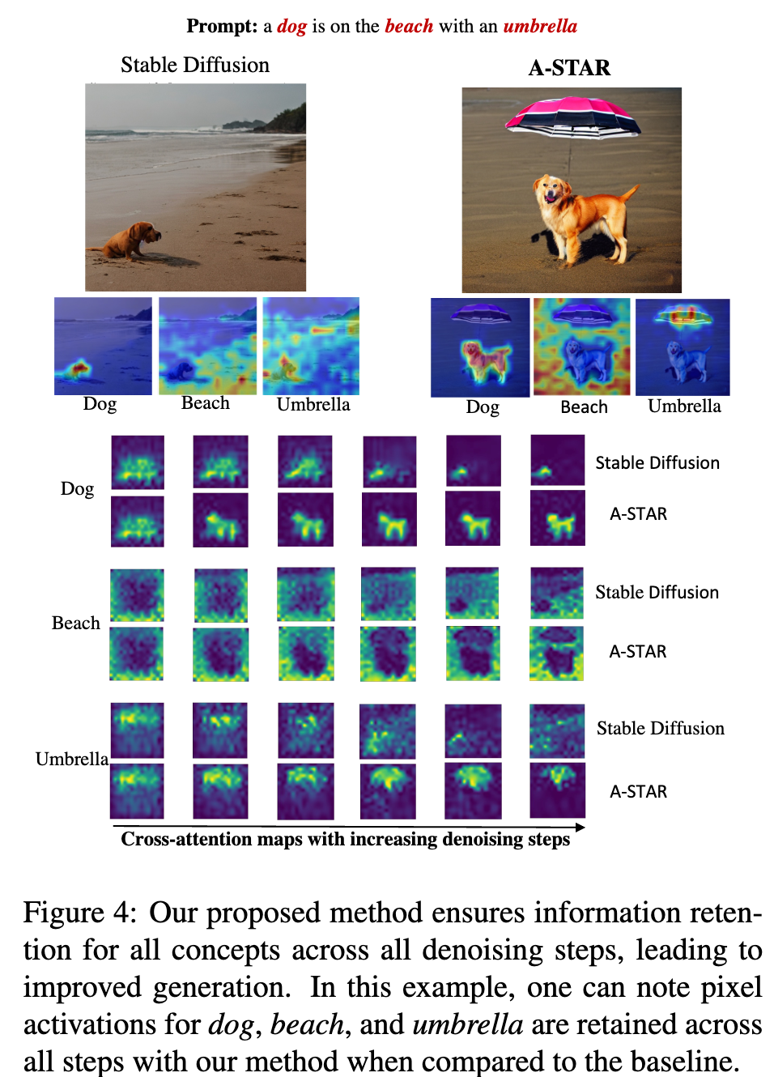
Related Works
A-STAR: Test-time Attention Segregation and Retention for Text-to-image Synthesis (CVPR, 2023)
Attention overlap → 줄이기
두 개념이 각각 주목하는 영역의 교집합 → 결과적으로 둘 중 하나를 포기하거나(누락) 이상하게 섞일 수 있음.
특정 토큰의 attn을 무작정 키우는 것(기존 유사 접근의 한계)이 아니라, 서로 다른 토큰의 공간적 책임 영역을 분리하도록 함.
Attention Decay → Attention 끝까지 유지되게 하기
초반에는 잡히던 개념이 후반 step으로 갈수록 희미해지는 현상
이전 step에서 특정 개념이 강하게 주목되던 위치(마스크)를 기준 삼고, 그 다음 step에서도 그 위치가 계속 주목되도록 강제하자.

Slide 4
Weekly Update Concept Erasing on UMM
2026.02.24
Hayeon Jeong

Slide 5
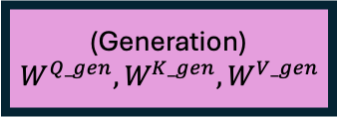





Architecture
Same Sequence (Packed)
[Text Tokens] + [VAE (image) Tokens]
X 28
[Text Tokens]
[VAE (image) Tokens]
(Understanding)
$$W^{Q_und}, W^{K_und}, W^{V_und}$$
(Generation)
$$W^{Q_gen}, W^{K_gen}, W^{V_gen}$$
[ Multi-modal Self Attention ]
Text Q, K, V
VAE Q, K, V
txt
vit
Self-Attention
(Understanding)
$${FFN}^{und}$$
(Generation)
$${FFN}^{gen}$$
vae
txt
vit
vae

Slide 6
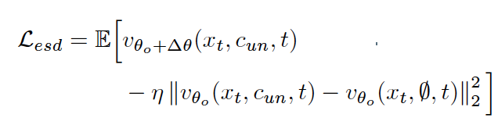


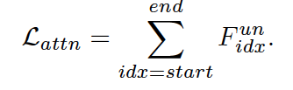
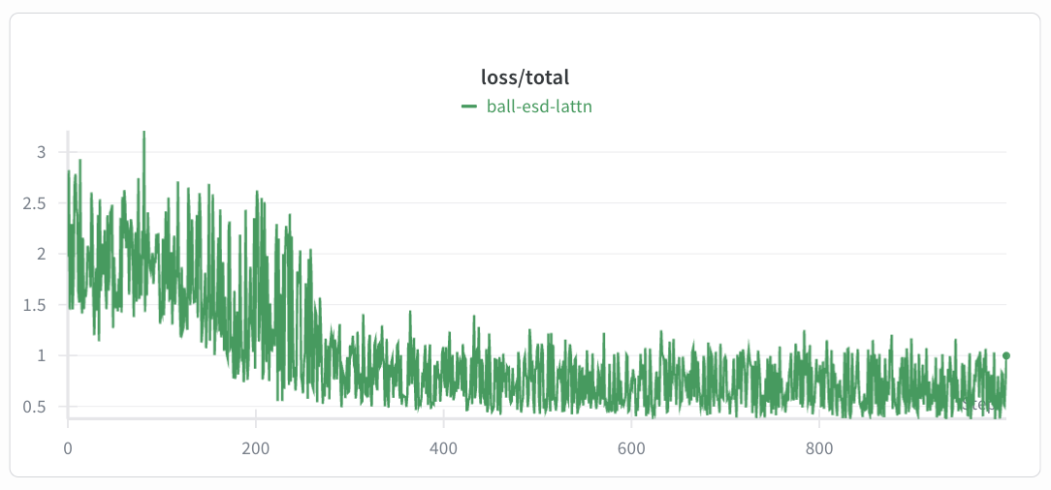
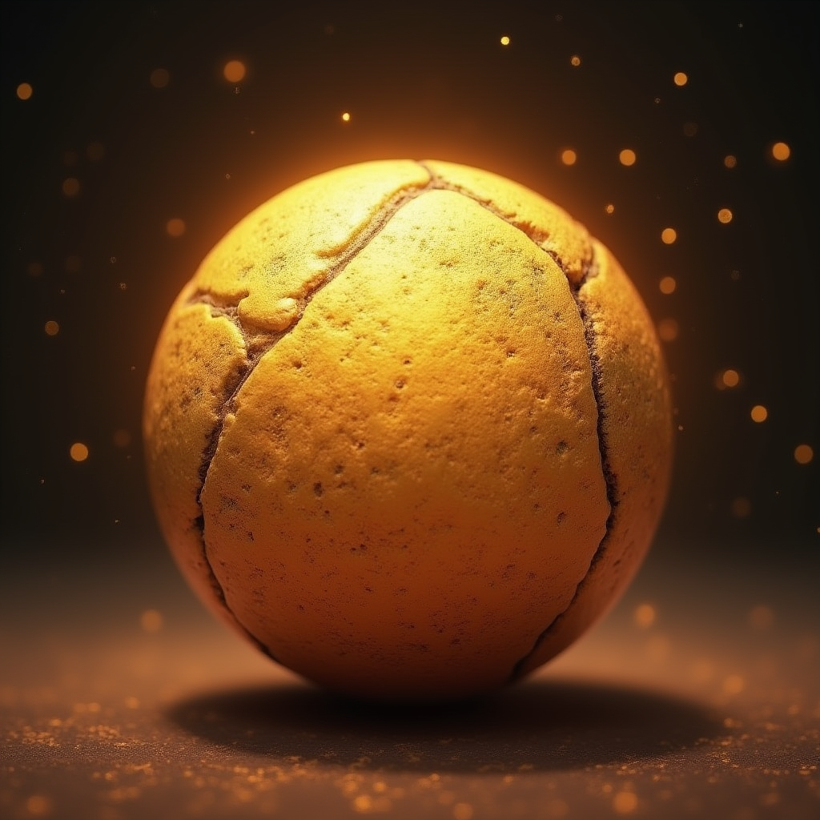
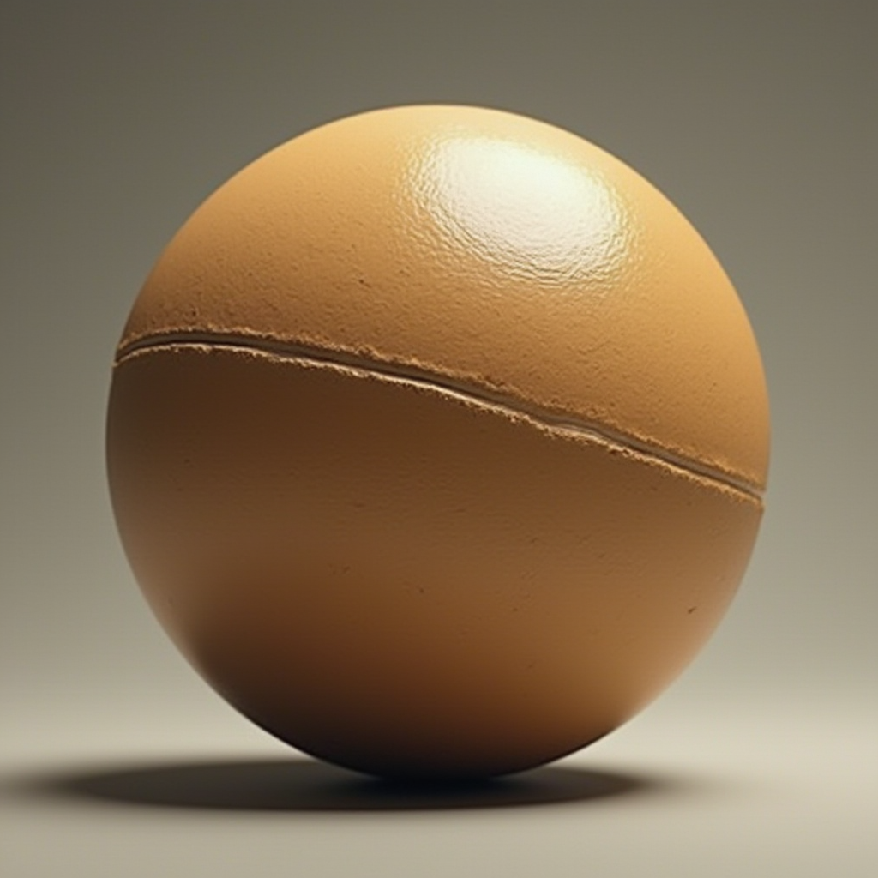

Previous Idea
A photo of a ball
A photo of a ball
Loss for erasing (EraseAnything)
Loss for preservation
$$KL(p_{θ}\left(y | x^{T}\right)|\left|p_{θ^{′}}\left(y | x^{T}\right)\right)≈0$$

Slide 7
Previous Idea
A photo of a ball
A photo of a ball
Cause of Failure
The number of parameters: attn <<< ffn
Just erased “ball” text/concept. → What about “ball which is ~”
Used method is just for all of the location of the image.
Limitation
Trade-off
How to evaluate?

Slide 8










New Approachment
Same Sequence (Packed)
[Text Tokens] + [VAE (image) Tokens]
X 28
[Text Tokens]
[VAE (image) Tokens]
(Understanding)
$$W^{Q_und}, W^{K_und}, W^{V_und}$$
(Generation)
$$W^{Q_gen}, W^{K_gen}, W^{V_gen}$$
Text Q, K, V
VAE Q, K, V
Self-Attention
(Understanding)
$${FFN}^{und}$$
(Generation)
$${FFN}^{gen}$$
$$z$$
$$h_{l=13}^{und_mlp_out}$$
$$h_{l=13}^{gen_mlp_out}$$
$$z$$
(txt top-k) ∪ (img top-k) - (img top-k)

